Slide 1
7th-8th Grade BAnd
While you wait, please get to know some of the other band families! It helps to have a support system if you ever need assistance, your student needs a ride, you have questions, etc.

Slide 2
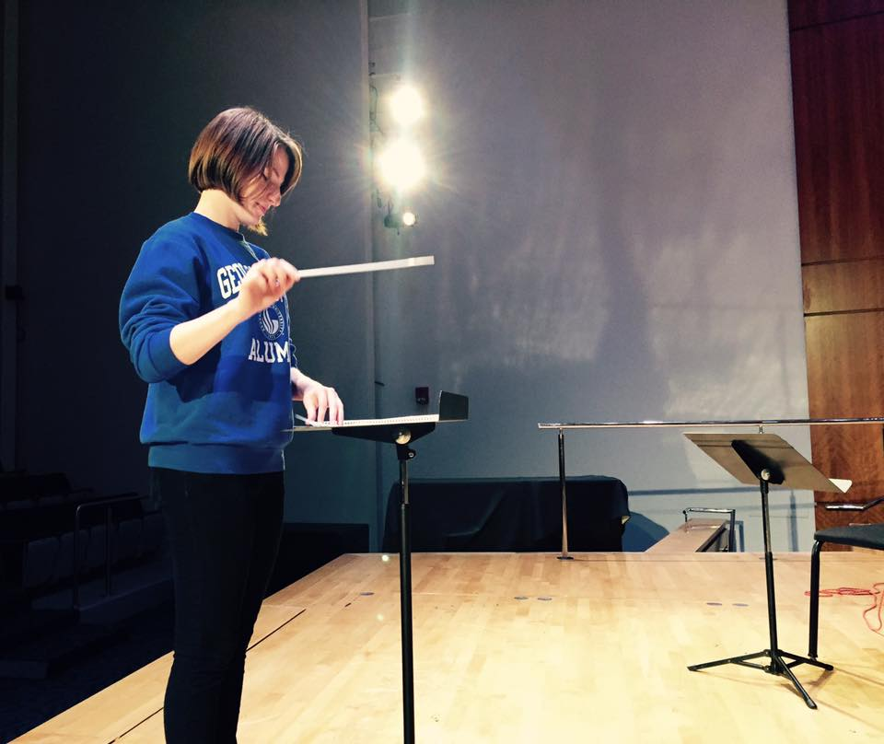
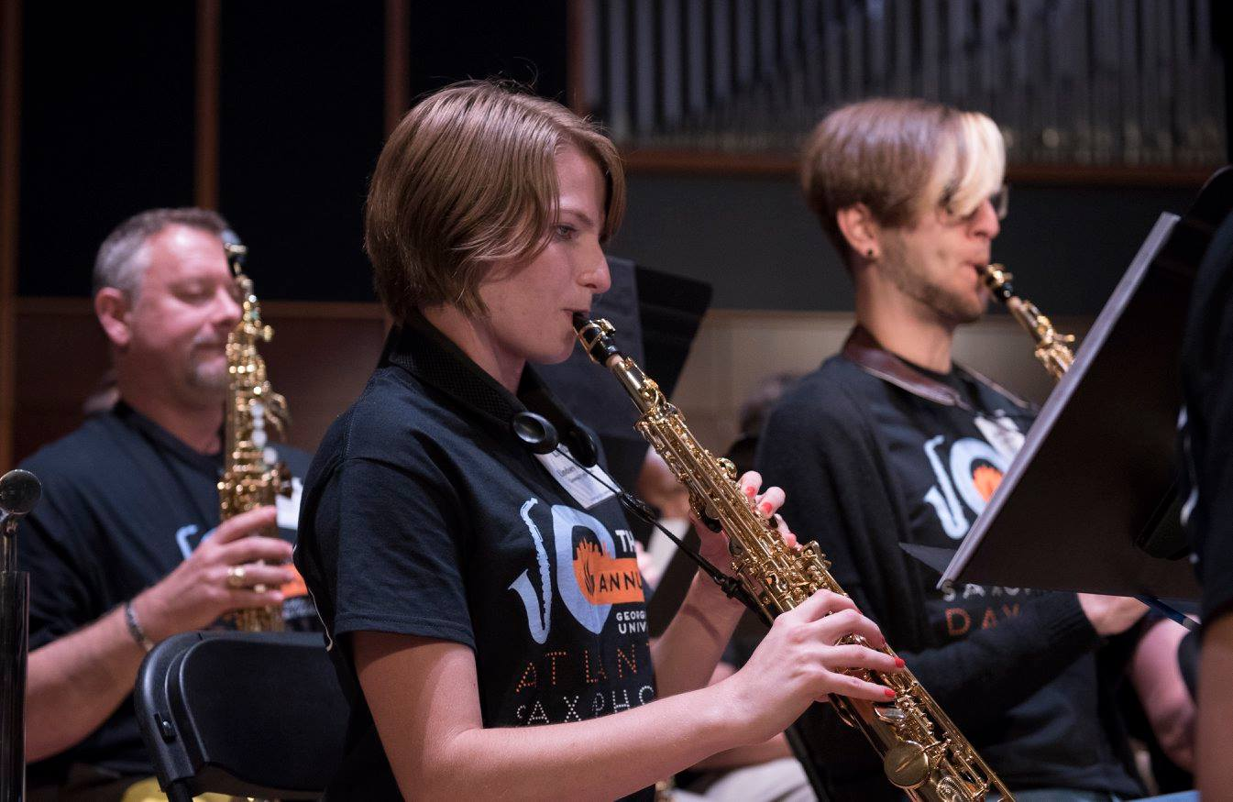
About Mrs. Foster
Go Panthers!
Woodwinds!

Slide 3
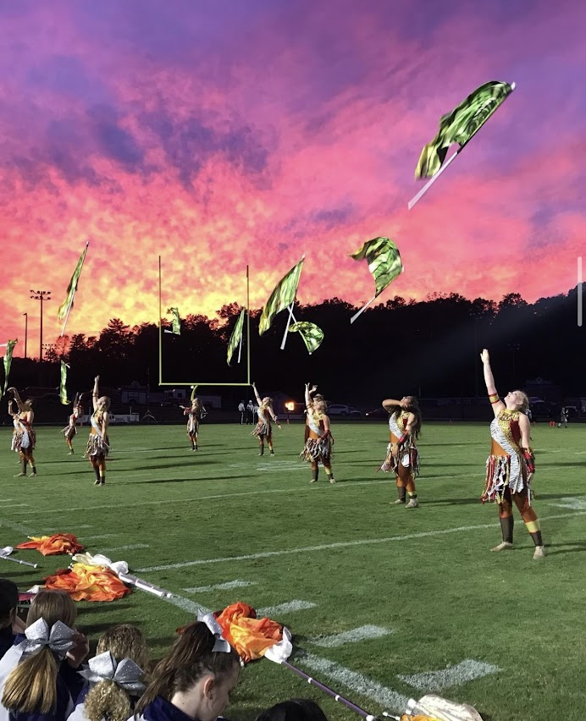
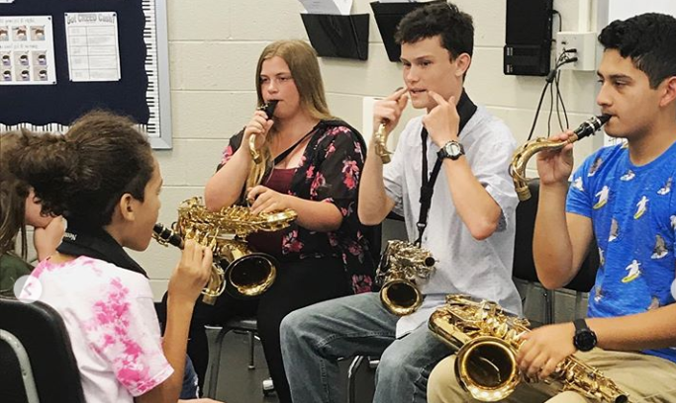
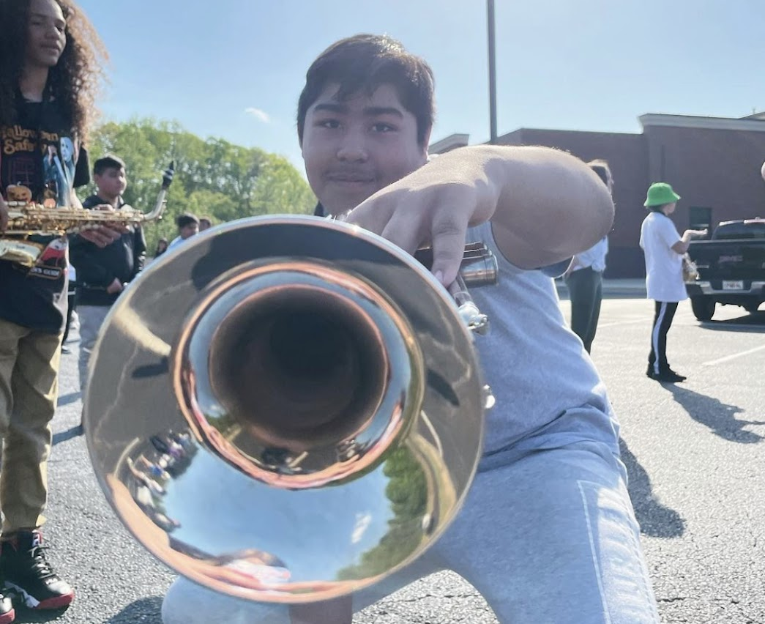
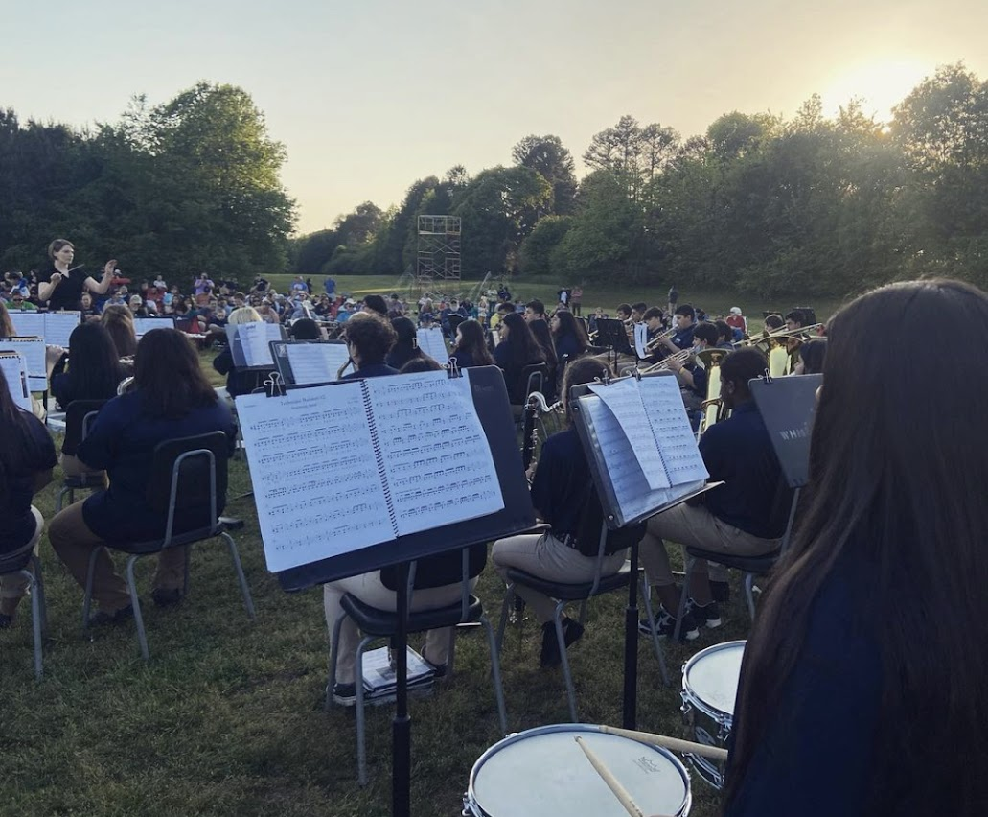
What is Band all about?

Slide 4
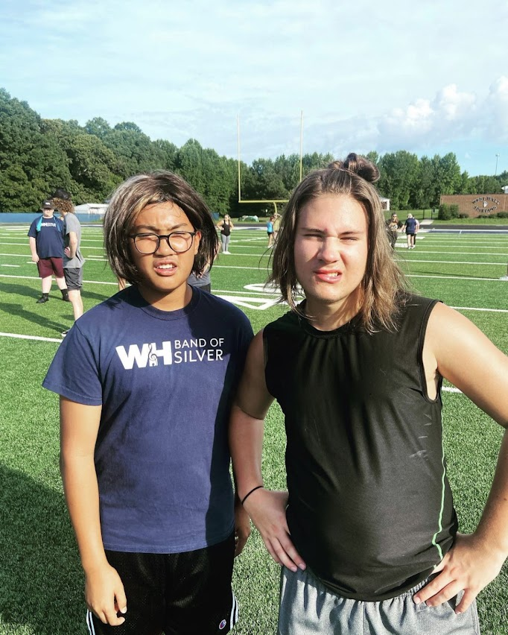
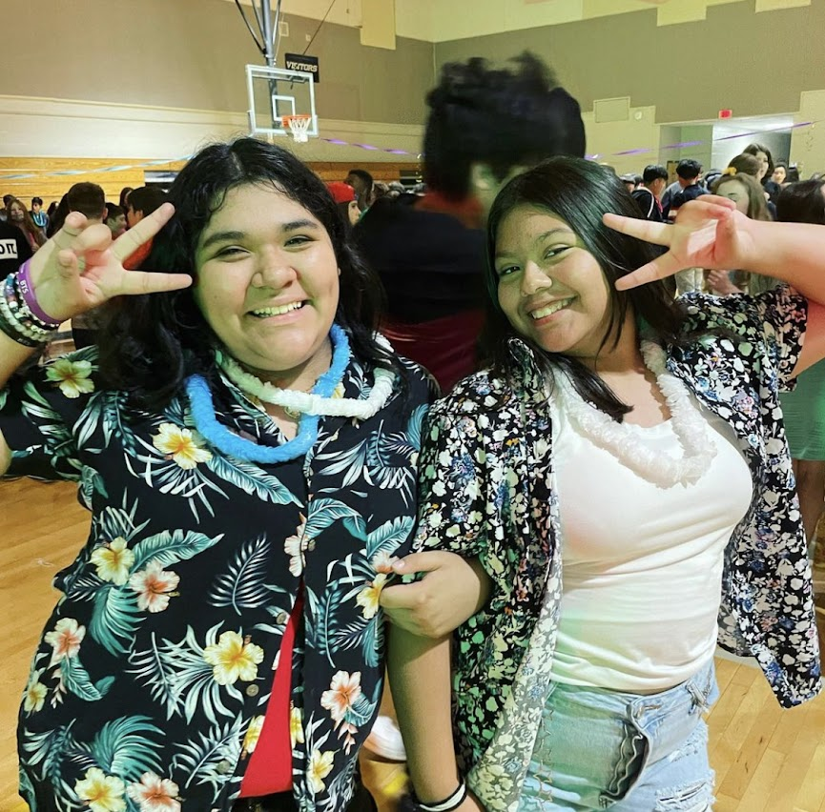
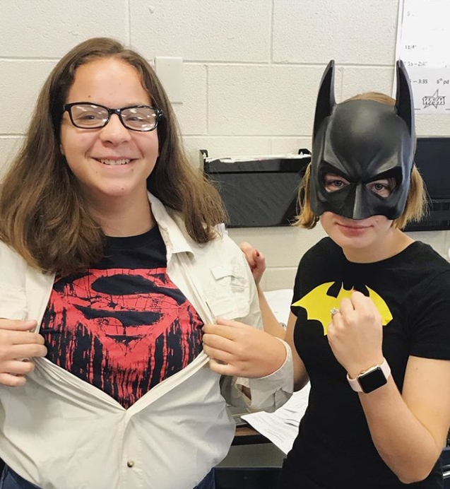
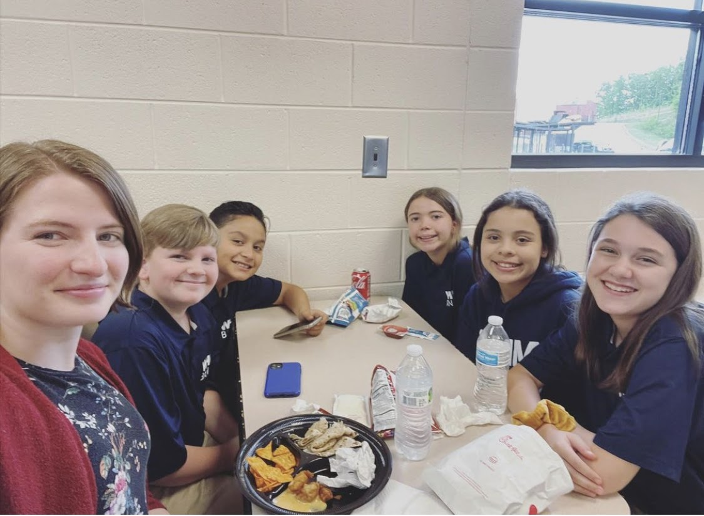
FUN!!!

Slide 5
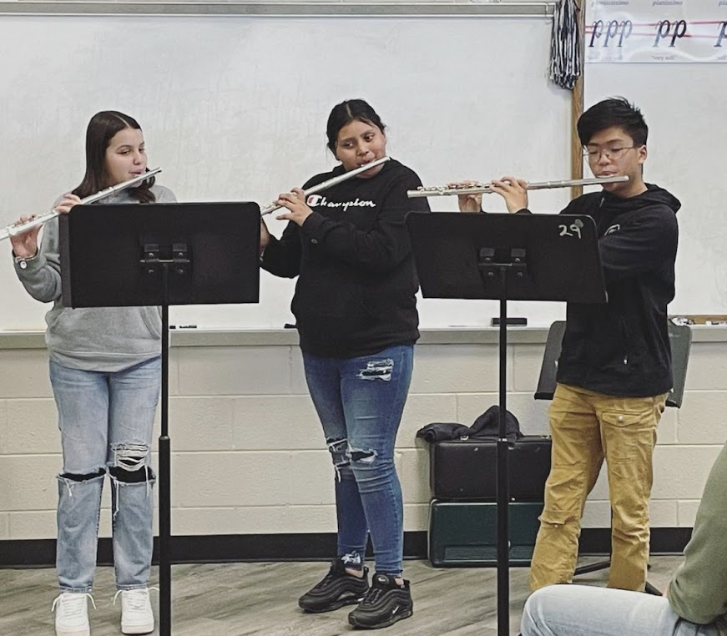
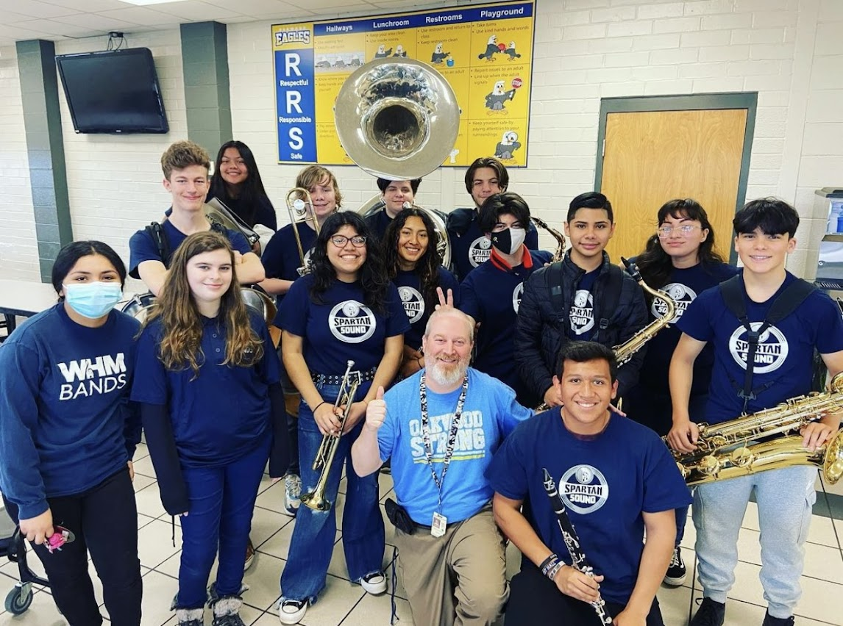

Slide 6
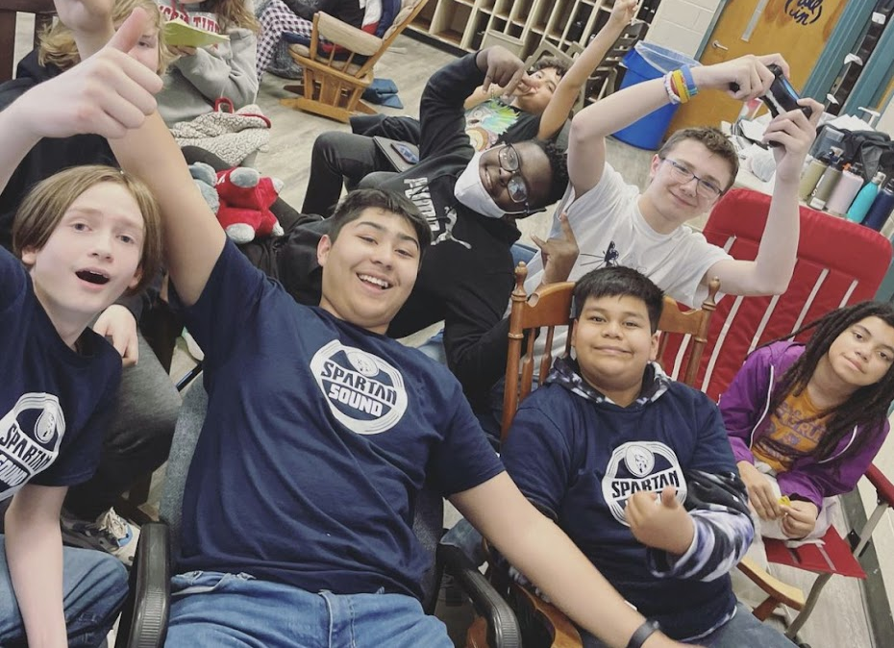
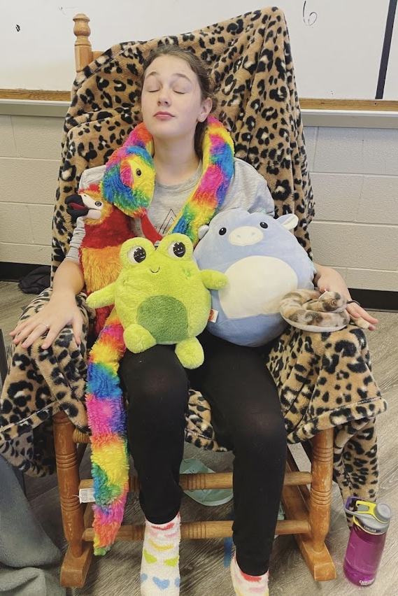
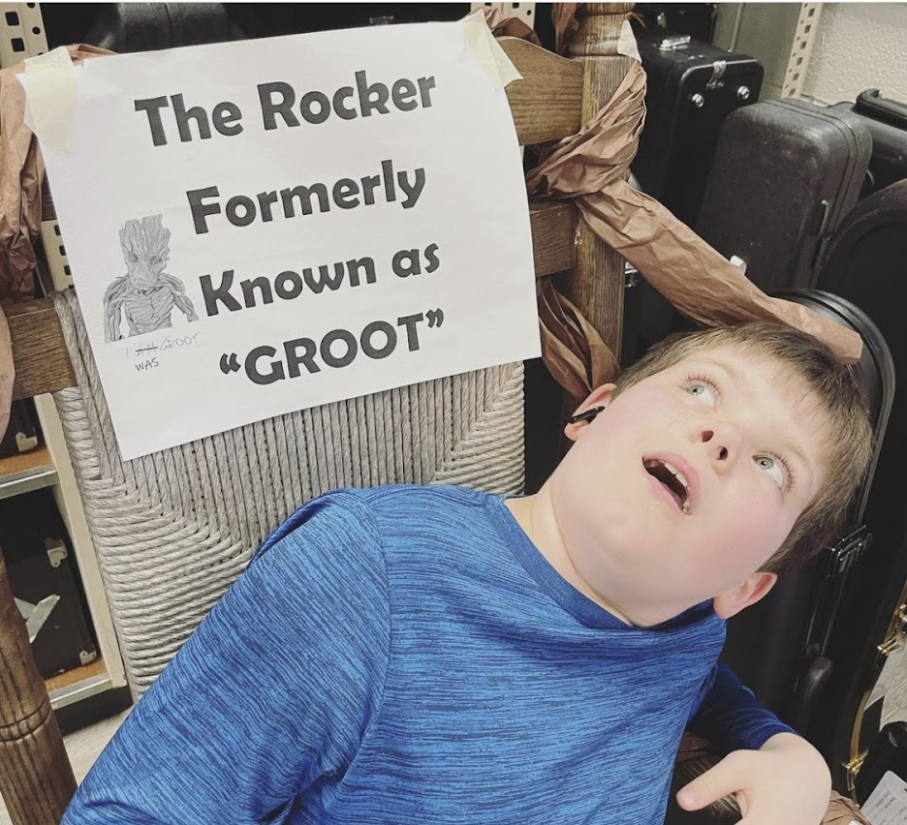
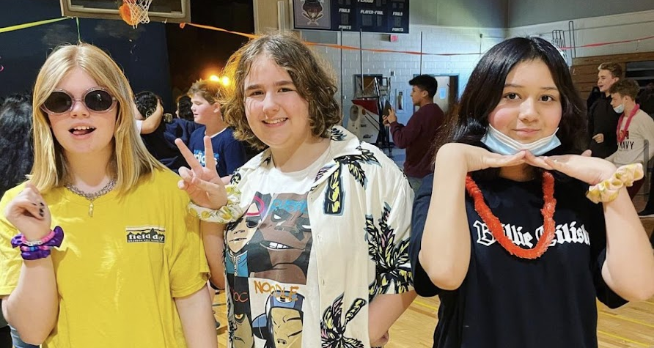

Slide 7
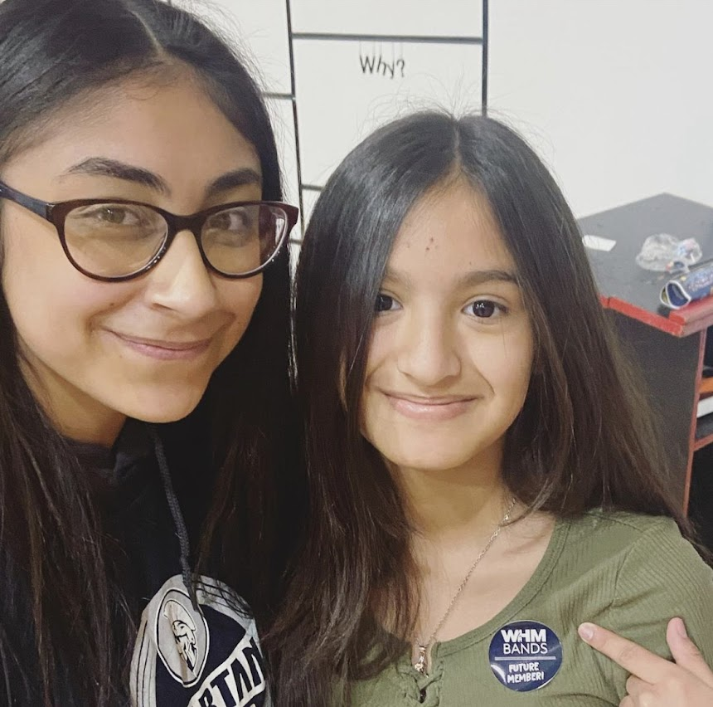
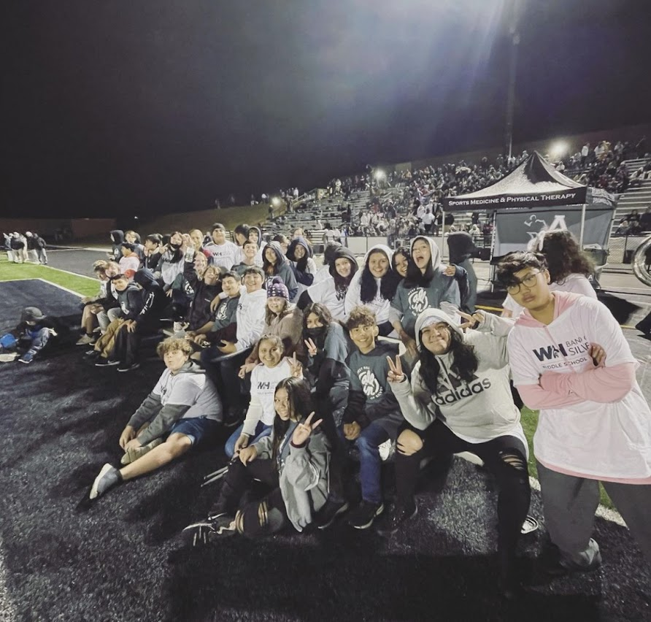
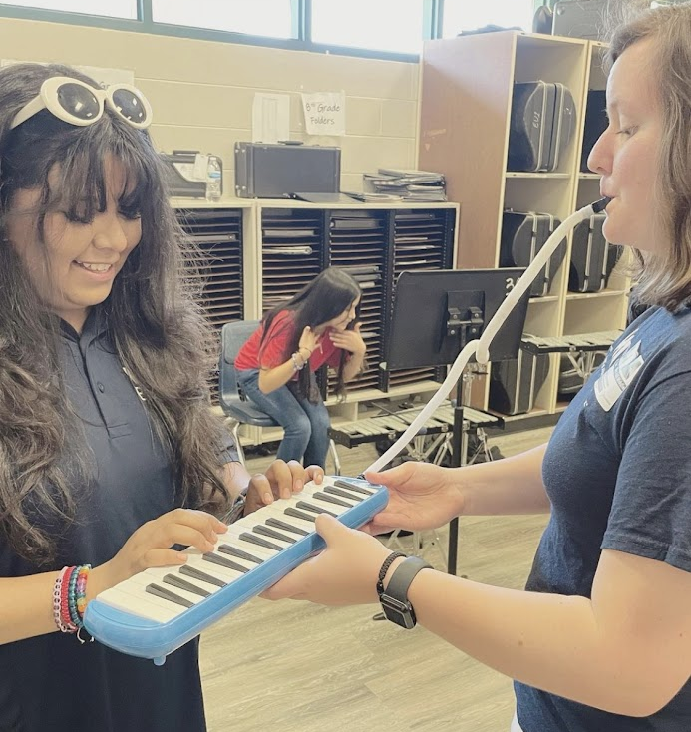
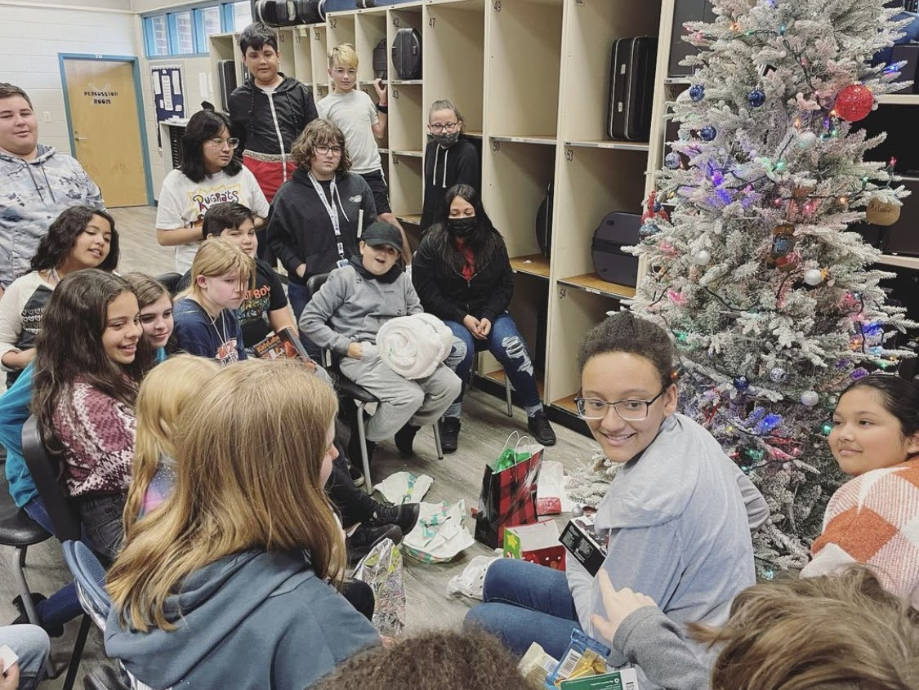
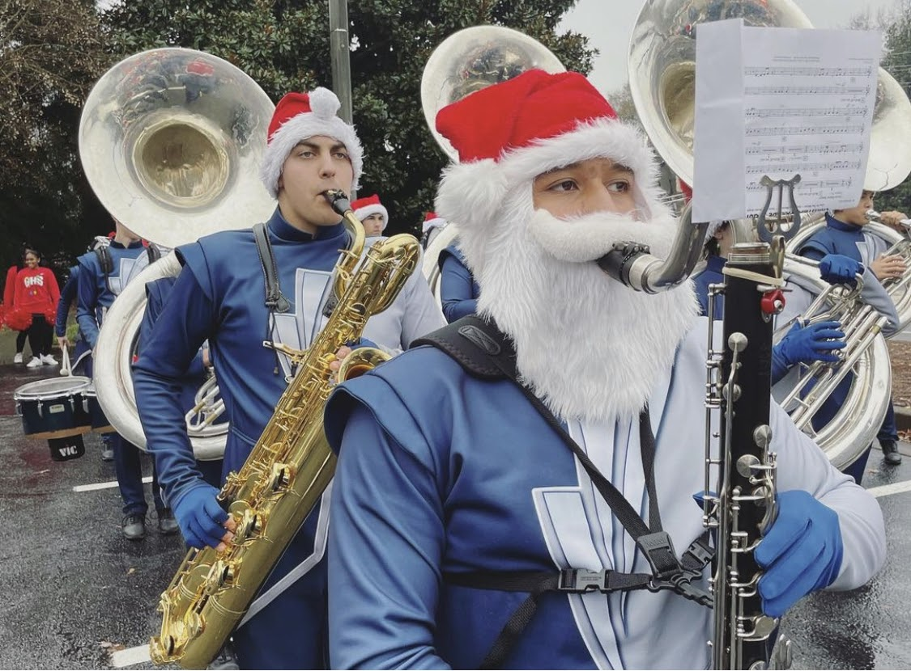
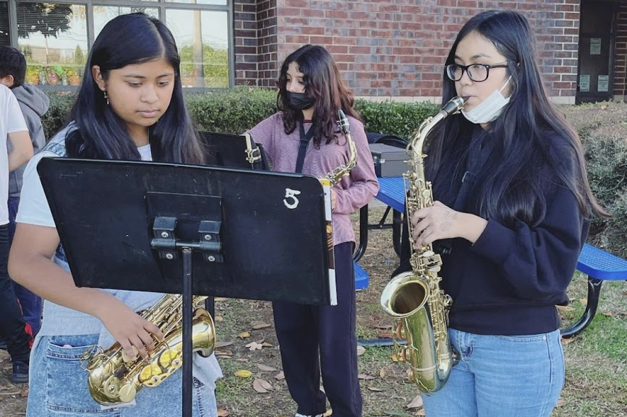

Slide 8
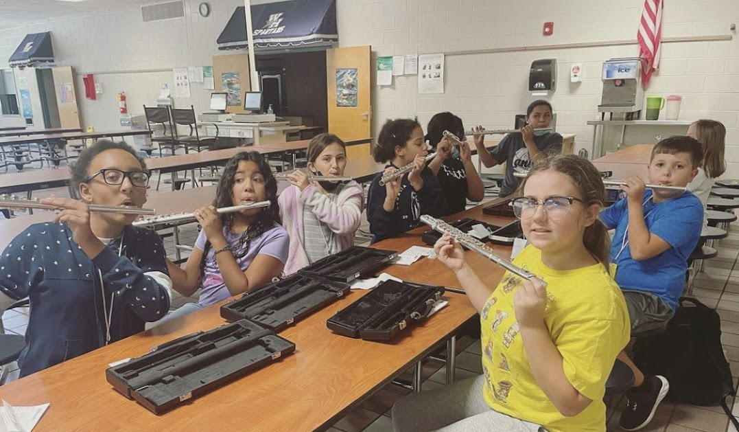
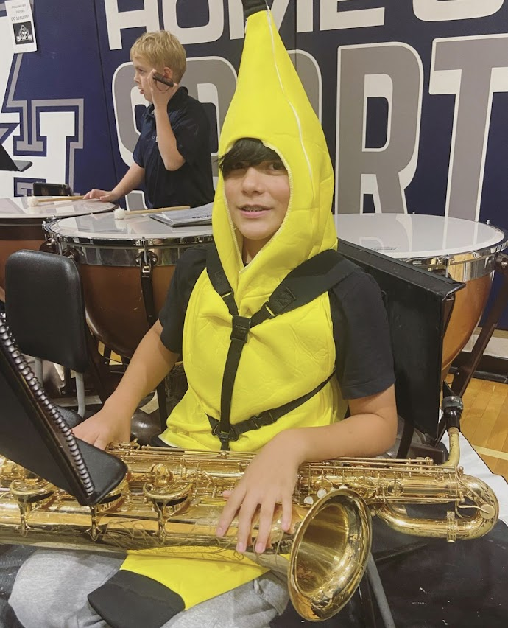
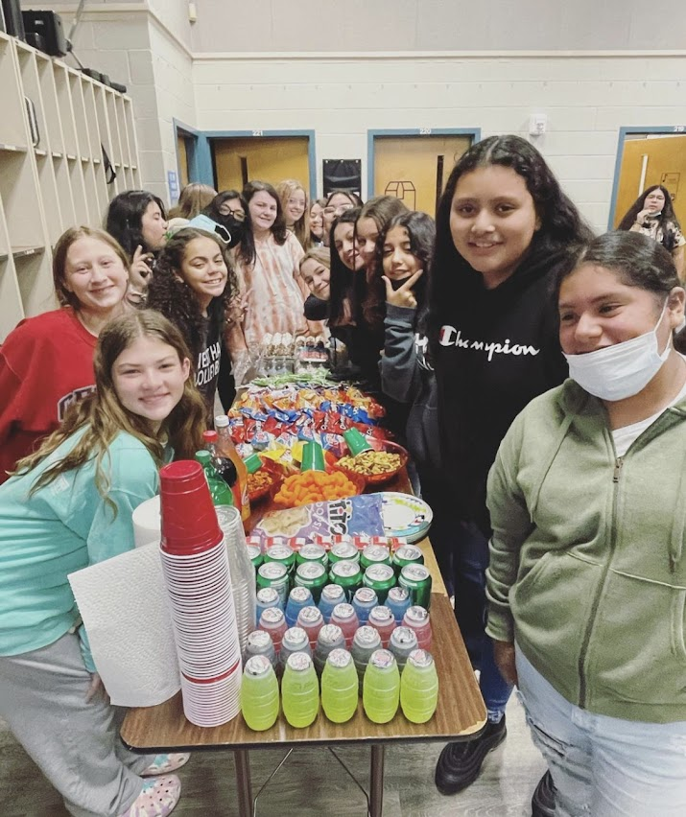
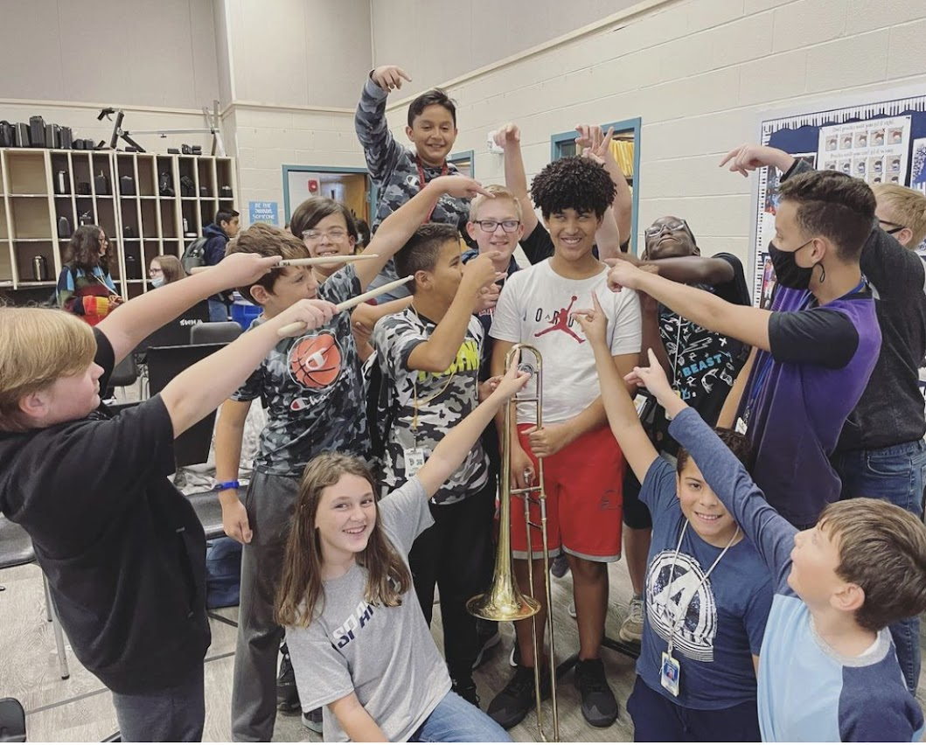
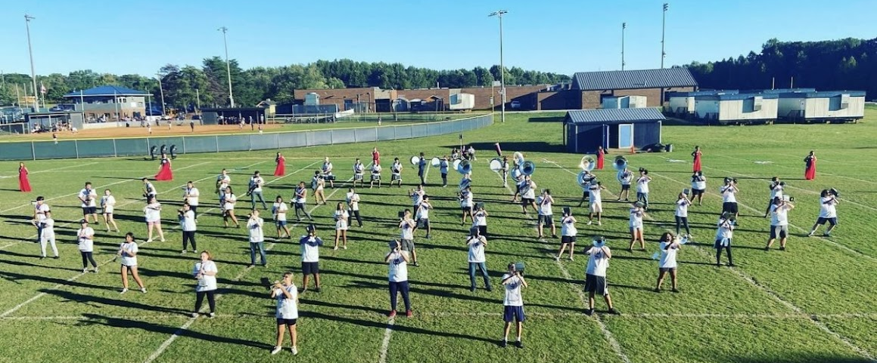

Slide 9
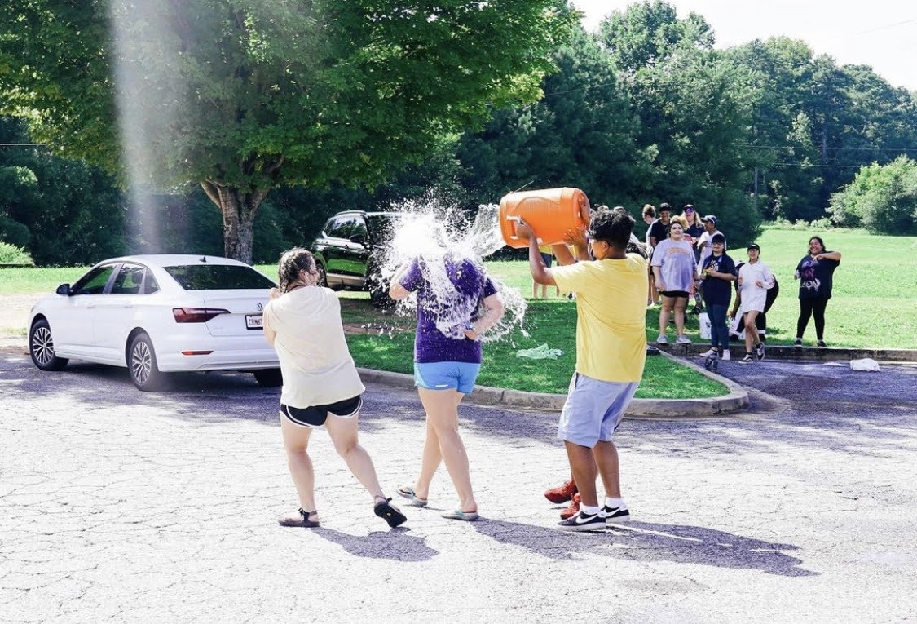
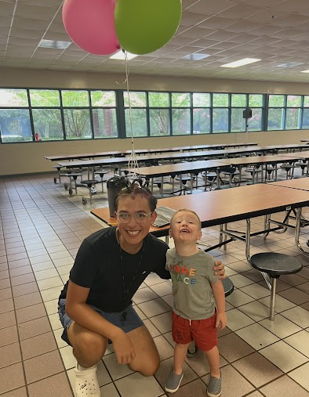
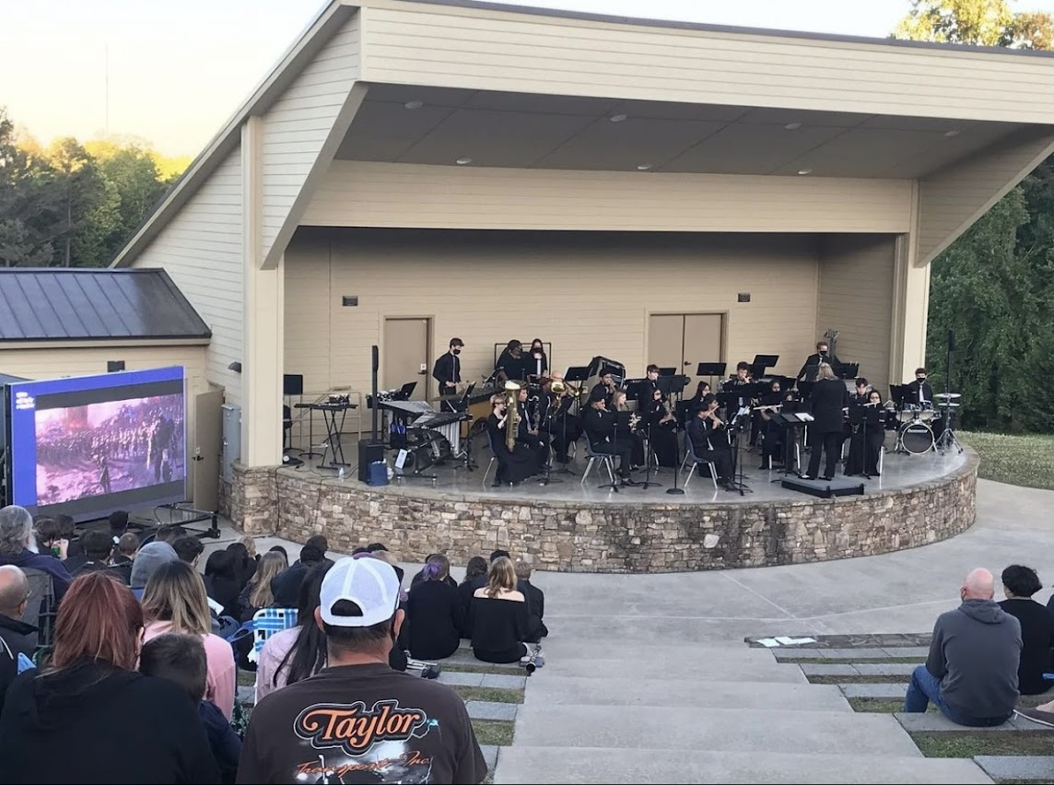
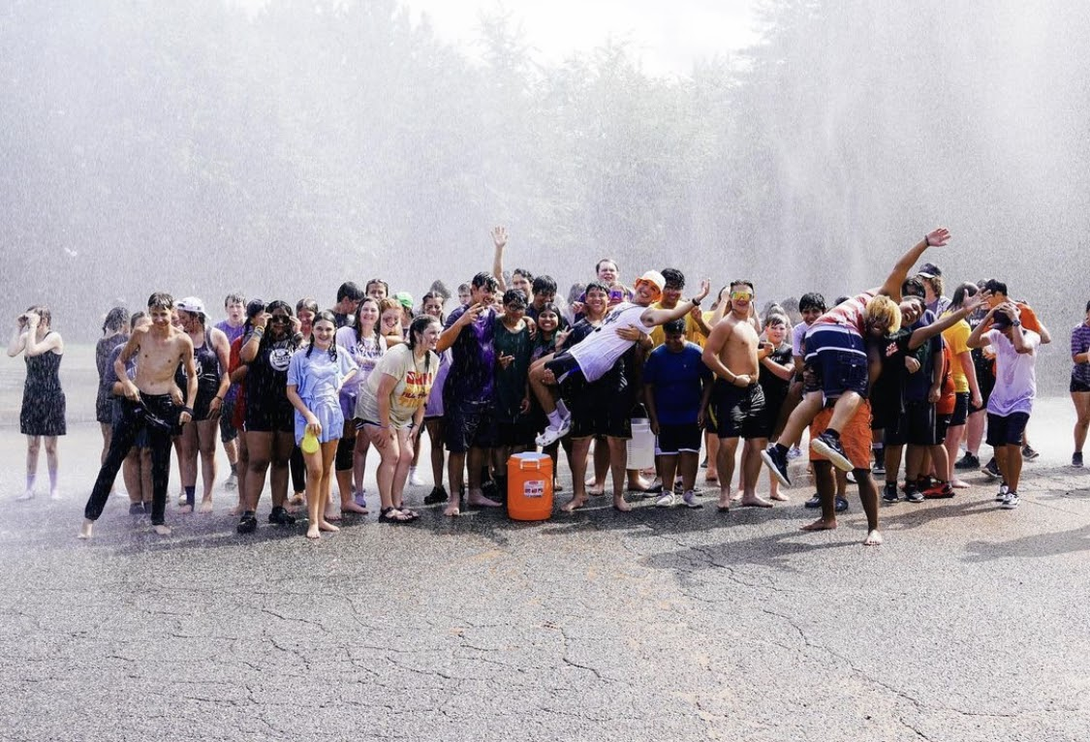
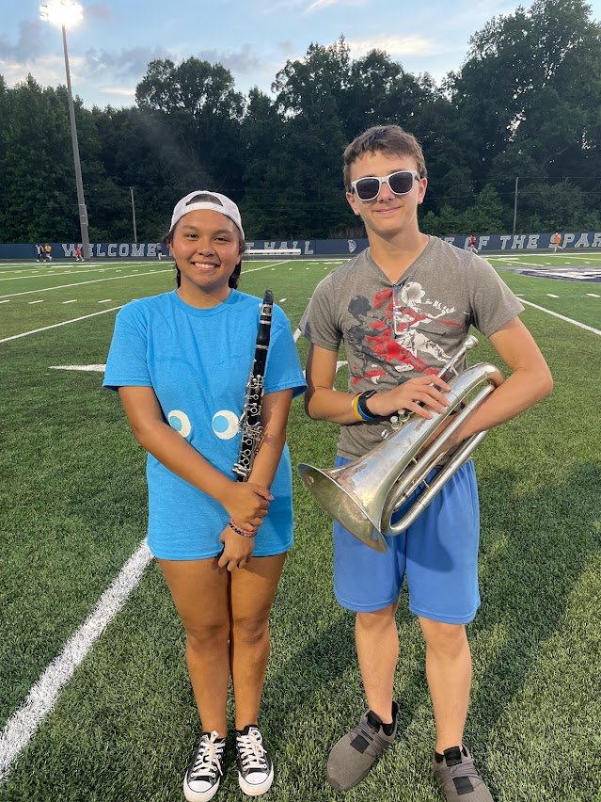
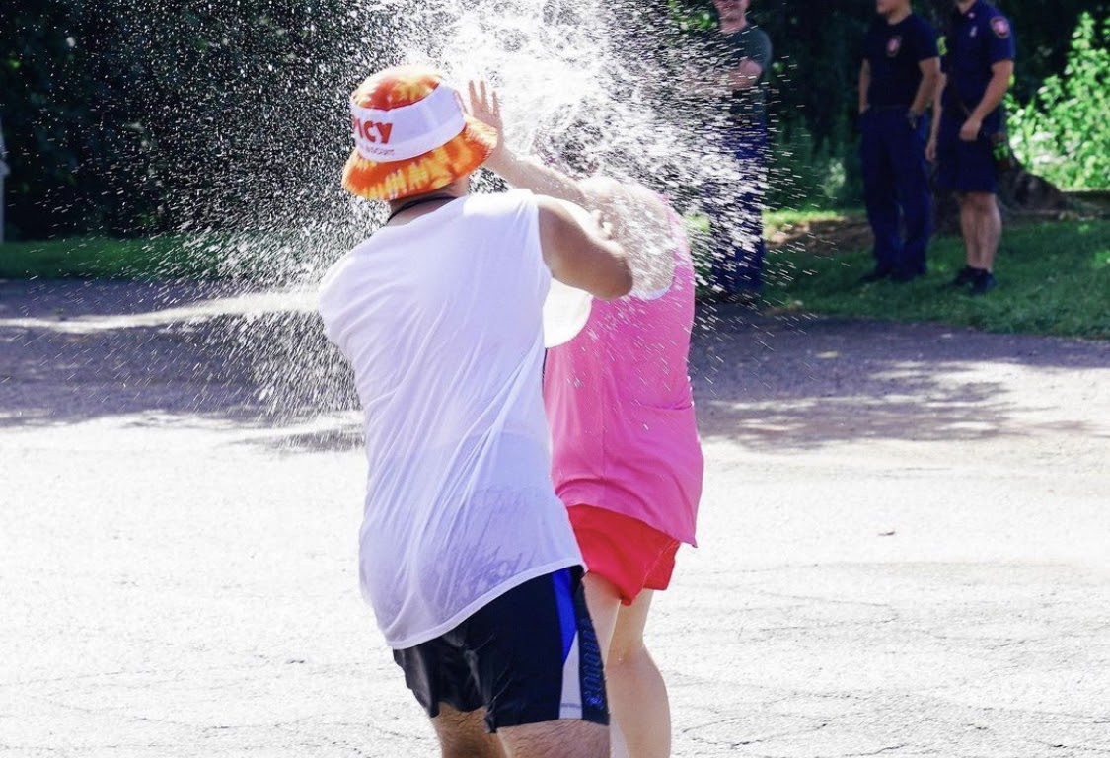

Slide 10
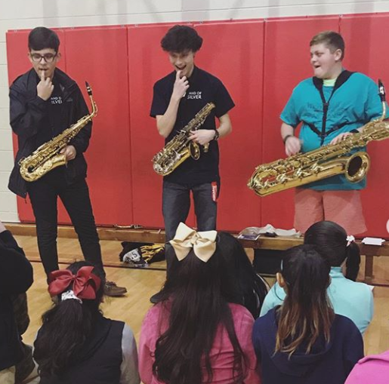
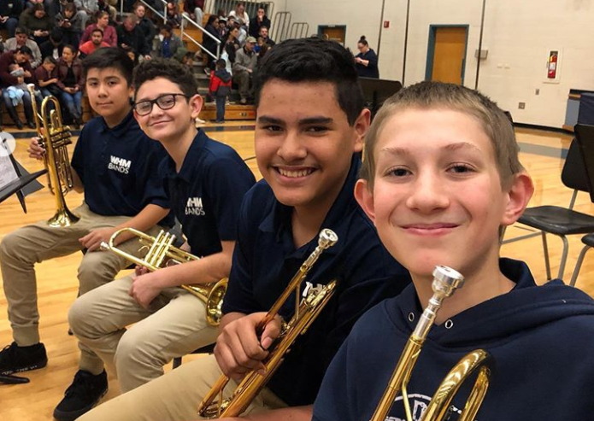
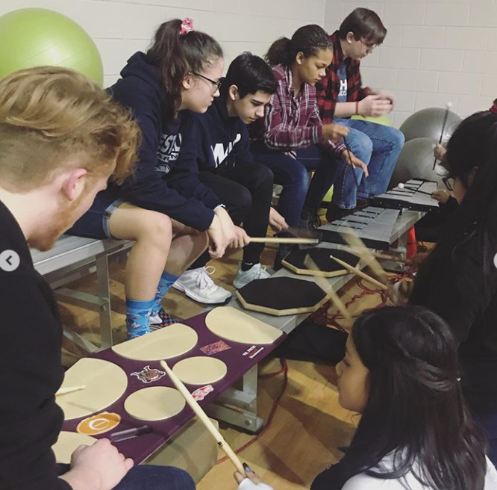
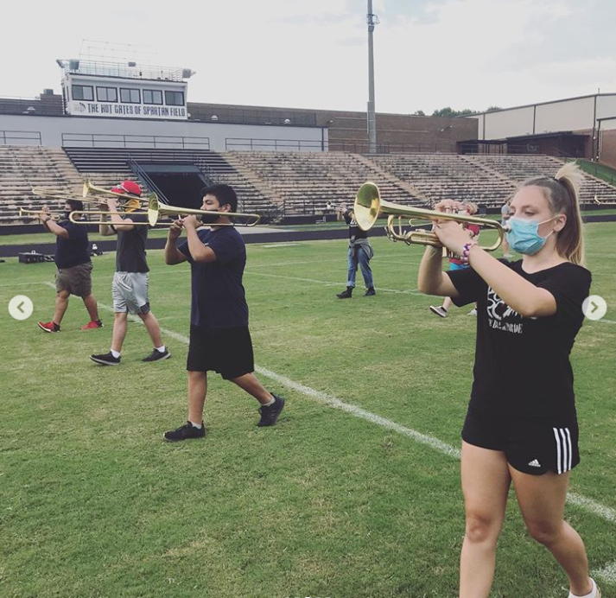
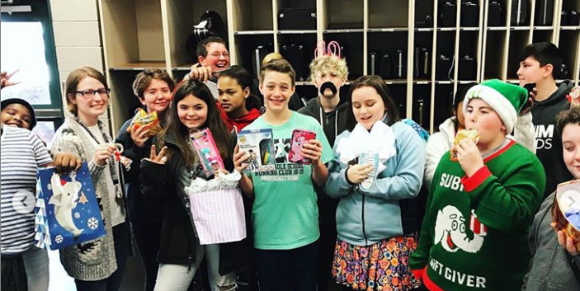
REMEMBER What Band Is Really All About… FUN!!!
Catch Band of Silver’s 2023 Marching Show, featuring some awesome middle schoolers!

Slide 11
Band Parent Perspective
Please welcome bpa Treasurer and Secretary, Amy Sumrack!

Slide 12
Band Parent Association
Please reach out to these band parents if you need anything! They are wonderful to work with and can answer many of your questions from the perspective of a parent.
President: Laura Lasseter
706-436-4346 or lauralasseter@gmail.com
Parent Liaison: Alejandra Arriaga
678-943-3008 or ronin80_23@hotmail.com
Treasurer/Secretary: Amy Sumrak
amysumrak@gmail.com

Slide 13
Supply Lists
Returning Members:
Black Binder
EE Book
Skills Book
Pencils
Instrument supplies
Concert uniform
Beginners:
Pencils
Khaki pants
Black socks
Black shoes

Slide 14
Jackson’s Instrument Rental
Jackson’s Music: alquiler de instrumentos
Jackson’s Music will be here to help us get started on August 21 at 6:00pm!
¡Jackson’s Music estará aquí para ayudarnos a comenzar el 21 de agosto a las 6:00 pm!

Slide 15
BAnd HAndbook / Manual del Programa de Banda
Mrs. Foster has physical copies if you would like one tomorrow. You can also find it on the West Hall band website!
BAND WEBSITE/CHARMS
La Sra. Foster tiene copias físicas si desea una mañana. También puede encontrarlo en el sitio web de la banda West Hall.

Slide 16
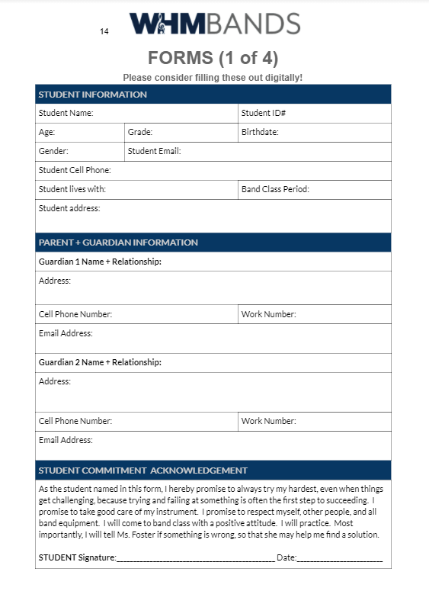
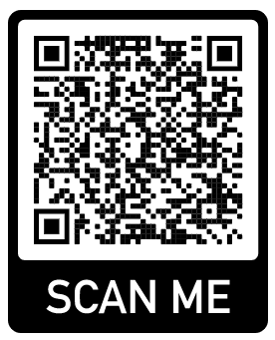
Band Forms / Formas de banda
Mrs. Foster has some physical copies, or you can fill them out digitally using this link:
La Sra. Foster tiene copias físicas, o puede completarlas digitalmente usando este enlace (en inglés):

Slide 17
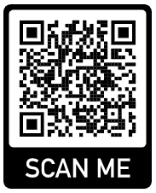
Beginning of the Year Checklist
Lista de verificación de comienzo de año- ¡Complete hoy!
Scan the Q.R. code, or go to the band website.
Click “Beginning of the Year Checklist”
Complete at least #1-6 before leaving tonight.
Pay band fees ($50 cash, check, or card)
Say hi to Mrs. Foster when done!
Escanea el Q.R. código, o Google "West Hall Band" y haga clic en el primer resultado.
Haga clic en "WHMS"
Haga clic en “Beginning of the Year Checklist”
Pagar tarifas de banda ($50 en efectivo, cheque o tarjeta)
¡Saluda a la Sra. Foster cuando haya terminado!

